Slide 1
Assessment of Refugees’ Qualifications: Challenges and Possible Solutions
Stig Arne Skjerven
Director of Foreign Education
NOKUT (Norwegian Agency for Quality Assurance in Education), Norwegian ENIC-NARIC

Slide 2
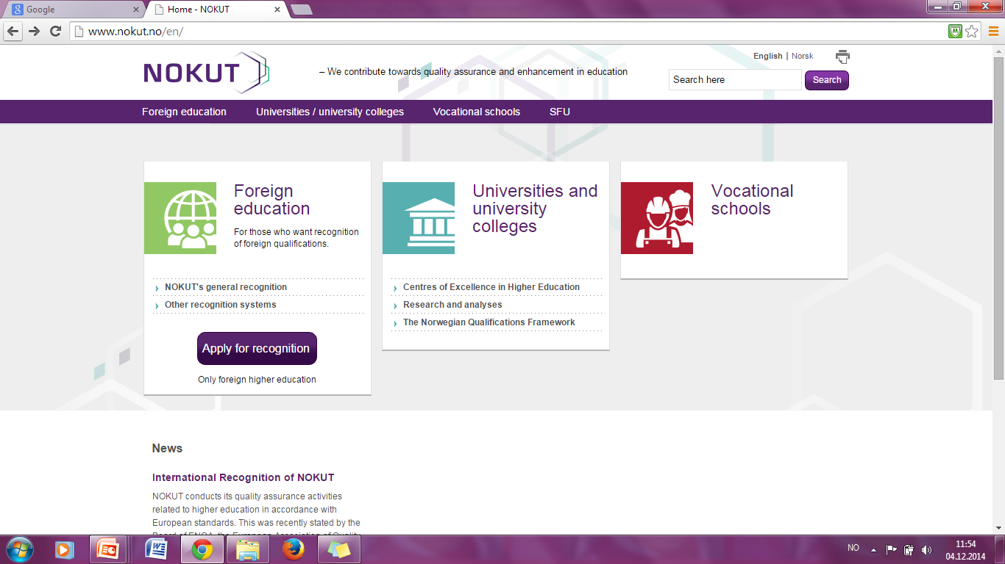
NOKUT – Norwegian Agency for Quality Assurance in Education
Independent agency, established by the Universities and Colleges Act in 2003
Notes:
NOKUT is an independent body, established in 2003. It works with higher education institutions and vocational higher education providers, as well
as individuals seeking to obtain recognition of their foreign qualifications, to ensure and
promote quality in higher and tertiary vocational education (supervision and control over the institutions’ internal quality systems, accreditation of new institutions and programs, and revision of their post-accreditation activities)

Slide 3
Article VII – Lisbon Recognition Convention
Each Party shall take all feasible and reasonable steps within the framework of its education system and in conformity with its constitutional, legal, and regulatory provisions to develop procedures designed to assess fairly and expeditiously whether
  refugees, displaced persons and persons in a refugee-like situation
fulfill the relevant requirements for access to higher education, to further higher education programmes or to employment activities,
  even in cases in which the qualifications obtained in one of the Parties cannot be proven through documentary evidence.

Slide 4
Recognition procedures for persons without verifiable documentation – alternative ways to recognition of qualification
Application for general recognition
Ordinary / paper based process for NOKUT's general recognition
Legally binding decision on recognition as on par with Norwegian higher education
- Assessment of documentation
- Verification, if necessary
Mapping of applicant’s background
NOKUT’s assessment/level placement of qualifications
Assessment by expert committee appointed by NOKUT
Recognititon procedure for persons without verifiable documentation (UVD-procedure)
Mapping of applicant’s background
NOKUT’s assessment/level placement of qualifications
Structured interview with NOKUT’s case officers
NOKUT’s Qualifications Passport for Refugees
NOKUT’s Qualifications Passport for Refugees

Slide 5
Norwegian experience
2005
2011-2012
2013
2014
2015
2016
2017
NOKUT / UK NARIC
proposal
European Qualifications Passport for Refugees
Special recognition procedure for refugees
Background paper
Standardized recognition procedure for refugees
HEIs + NOKUT
NOKUT’s UVD-procedure is established
Legally binding decision
UVD-methodology is crucial in Students at Risk scheme
NOKUT’s Qualifications Passport for Refugees
Pilot project
Qualifications Passport for Refugees is being tested in Greece
NOKUT’s Qualifications Passport for Refugees to be established

Slide 6
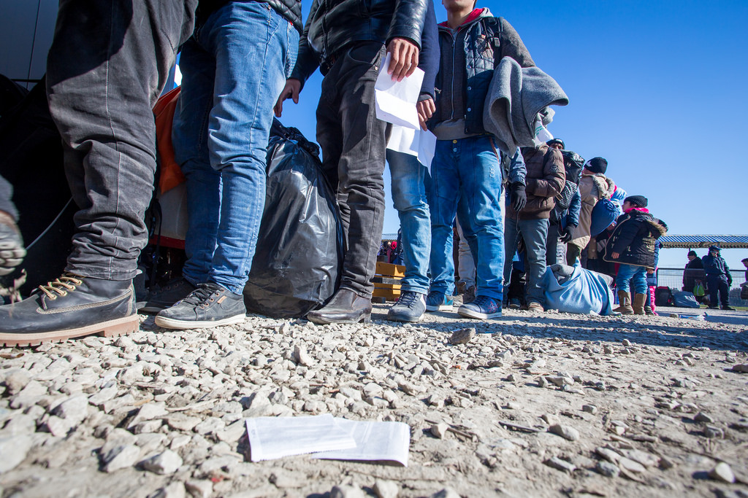
Current challenges
Volumes
Language competency
Unfinished qualifications
Demand for mobility and portability

Slide 7
Let us stop for a minute … what are we actually talking about?
Recognition is more than a technical exercise
Recognition is more than a preparation for further studies or employment
Early recognition of refugees` qualifications is a key to build inclusive societies
Recognition of a qualification = recognition of the human behind the qualification
Inclusion – empowerment – participation
Reduce the risk of (social, political, economical) alienation

Slide 8
What kind of solution we need?
Early / Fast
Effective
Accessible
Professional
Fair / provides equal treatment
Provides relevant information
Provides feasible system for transition and easy mobility between regions, educational levels and even countries

Slide 9
Current challenges and possible solutions
Current refugee crisis concerns all European states, but:
Different legislations
Different assessment practices
Different financial capacity situation
Different number of refugees

Slide 10
The path to a multi-national tool to assess refugees’ qualifications
September 2015
  Norwegian ENIC-NARIC (NOKUT) and UK NARIC proposed the idea of a European Qualifications Passport for Refugees
    Inspiration: The Nansen Passport
February – June 2016
  Methodology successfully tested in a pilot project in Norway
March – December 2017
  Pilot project in Greece by the Council of Europe and Greek authorities in cooperation with UNHCR
  Assessments, including interviews
  Recognition experts from Greece, Italy, Norway and UK
www.eurieeducationsummit.com
Notes:
Important with experts from many countries – also a way of capacity building on methodology bigger than in this concrete project

Slide 11






European Qualifications Passport for Refugees
June 2017
September 2017
December 2017
October 2017
April 2017
March 2017
First evaluation visit
Second project coordination meeting
Second evaluation visit
Third evaluation visit
Third project coordination meeting
Reporting

Slide 12
European Qualifications Passport for Refugees
Goal - To map, summarize and present available information on the applicant’s educational level, work experience and language proficiency, in order to provide information that can be relevant to applications for employment or internship, qualification courses and admission to studies.
Method – combination of an assessment of available documentation and a structured interview, conducted by a qualified credential evaluator, identification of missing documentation by use of previously evaluated cases

Slide 13
European Qualifications Passport for Refugees
Outcome – European Qualifications Passport for Refugees – contains following information:
Assessed education
Highest achieved qualification:
  Official name of the study/degree, field of study/specialization, educational institution, country
Other qualifications:
  Official name of the study/degree, field of study/specialization, educational institution, country
Additional relevant information
  Languages – native speaker, language of instruction, others
  Work experience and membership in professional organizations

Slide 14

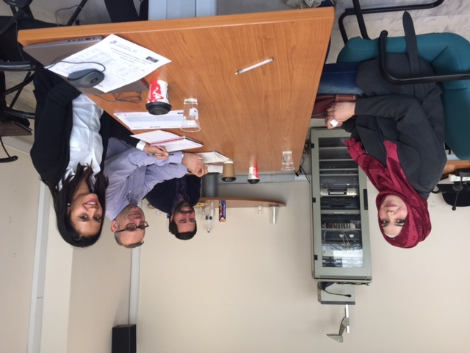
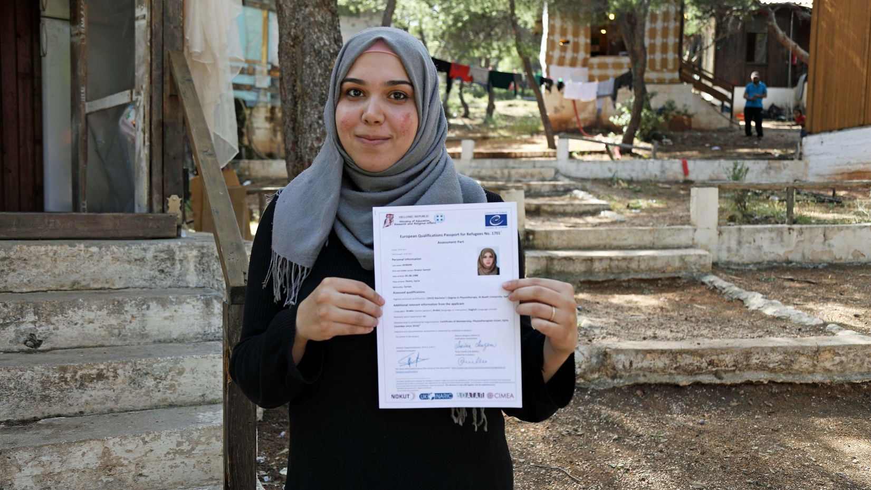
European Qualifications Passport for Refugees

Slide 15

European Qualifications Passport for Refugees
http://www.coe.int/en/web/education/recognition-of-refugees-qualifications

Slide 16




Refugees and Recognition - Toolkit for recognition of higher education for refugees, displaced persons and persons in a refugee-like situation
“Refugees and Recognition – Toolkit for recognition of higher education for refugees, displaced persons and persons in a refugee-like situation” by the ENIC-NARIC centres of France, Italy, the Netherlands, Norway and the United Kingdom.
Aim of the project - Development of appropriate common recognition methods and tools to secure effective and streamlined recognition of qualifications for refugees and persons in a refugee-like situation in signatory countries of The Lisbon Recognition Convention, as stated in Article VII.
Notes:
Addressing objectives of the NARIC Invitation, section 2.1 (c ), this project aims to contribute to development of appropriate common recognition methods and tools to secure effective and streamlined recognition of qualifications for refugees and persons in a refugee-like situation in signatory countries of The Lisbon Recognition Convention, as stated in Article VII.

Slide 17
Framework and scope
“Refugees and Recognition – Toolkit for recognition of higher education for refugees, displaced persons and persons in a refugee-like situation” by the ENIC-NARIC centres of France, Italy, the Netherlands, Norway and the United Kingdom.
Erasmus+
KA3: Support for Policy Reform
NARIC call 2016-2018
Category 6.2.1.Thematic project for improving recognition practices
Refugees and Recognition – 572356-EPP-1-2016-1-NO-EPPKA3-NARIC
April 2016 – March 2018
Estimated budget 209 566,00 € (EU grant 157 174,50 €)
Erasmus+

Slide 18
Timeline
“Refugees and Recognition – Toolkit for recognition of higher education for refugees, displaced persons and persons in a refugee-like situation” by the ENIC-NARIC centres of France, Italy, the Netherlands, Norway and the United Kingdom.
Kick-off seminar
Country profiles
Publishing of the results
Reporting on the results
Elaboration of common guidelines
Publishing of the country profiles
Final dialogue seminar for project partners
Elaboration of common procedures
Elaboration of common statement
Development of e-Learning modules
Trial of the developed toolkit
1st meeting
Norway
2nd meeting Italy
3rd meeting UK
final meeting France
1
2
3
4
5
6
7
8
9
10
11
January 2017
June – November 2016
November 2017
August 2016 – January 2017
September 2016 – January 2017
April – October 2017
June – December 2016
June 2016
October 2017 – February 2018
January 2017 – June 2017

Slide 19
Aim and objectives
“Refugees and Recognition – Toolkit for recognition of higher education for refugees, displaced persons and persons in a refugee-like situation” by the ENIC-NARIC centres of France, Italy, the Netherlands, Norway and the United Kingdom.
Effective recognition procedures for refugees, displaced persons and persons in a refugee-like situation, including those without official documentation
Common methodology
Common statement
E-Learning modules
Country profiles

Slide 20






Country briefings
“Refugees and Recognition – Toolkit for recognition of higher education for refugees, displaced persons and persons in a refugee-like situation” by the ENIC-NARIC centres of France, Italy, the Netherlands, Norway and the United Kingdom.

Slide 21
Testing of toolkit
“Refugees and Recognition – Toolkit for recognition of higher education for refugees, displaced persons and persons in a refugee-like situation” by the ENIC-NARIC centres of France, Italy, the Netherlands, Norway and the United Kingdom.
April 2017 - CIMEA
May 2017- CIEP
October 2017 - ArmENIC
Background paper
Qualifications Passport for Refugees

Slide 22
E-learning modules – NUFFIC, UK NARIC and NOKUT
“Refugees and Recognition – Toolkit for recognition of higher education for refugees, displaced persons and persons in a refugee-like situation” by the ENIC-NARIC centres of France, Italy, the Netherlands, Norway and the United Kingdom.
The tools available
How to use the toolkit
Case studies / demonstration on how those tools are used
Flow chart to demonstrate the sequence of events
September 2017 - Development
December 2017- Ready to promote
January 2018 – Series of 3 webinars

Slide 23
The way ahead
Coordinating an Erasmus+ project on development of toolkit for recognition of refugees’ qualifications;
Testing Qualifications Passport for Refugees in Greece – pilot project initiated by Council of Europe in cooperation with Greek Ministry of Education and UNHCR;
NOKUT’s Qualifications Assessment for Refugees is being established on the permanent basis at NOKUT from January 2017;
Methodology can be applied to other similar processes, e.g. identification of the potential students, qualified personnel in a special field of study etc.
Continue our close cooperation with Norwegian HEIs in Akademisk dugnad, bridging programs, working groups, StAR etc.

Slide 24
Thank you for your attention!
Stig Arne Skjerven
Director of Foreign Education
Norwegian Agency for Quality Assurance in Education – Norweigan ENIC-NARIC
stig.arne.skjerven@nokut.no

