Slide 1


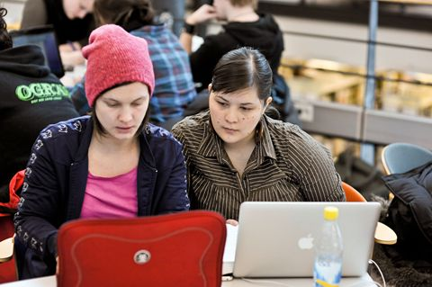
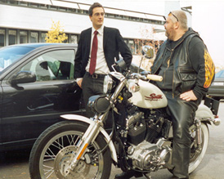
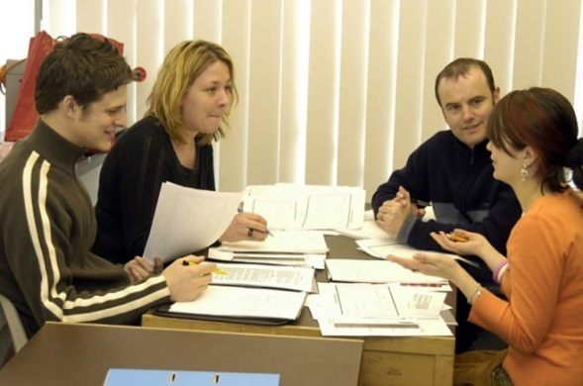
Intercultural communication competences – What? Why? And how?
Yael Tågerud
Development consultant
Office of Human Resources

Slide 2
Intercultural communication competences
"the degree to which an individual is able to exchange information effectively and appropriately with individuals who are culturally dissimilar“
(Rogers & Steinfatt 1998)

Slide 3
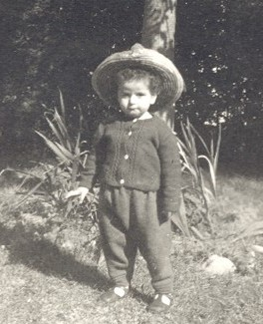


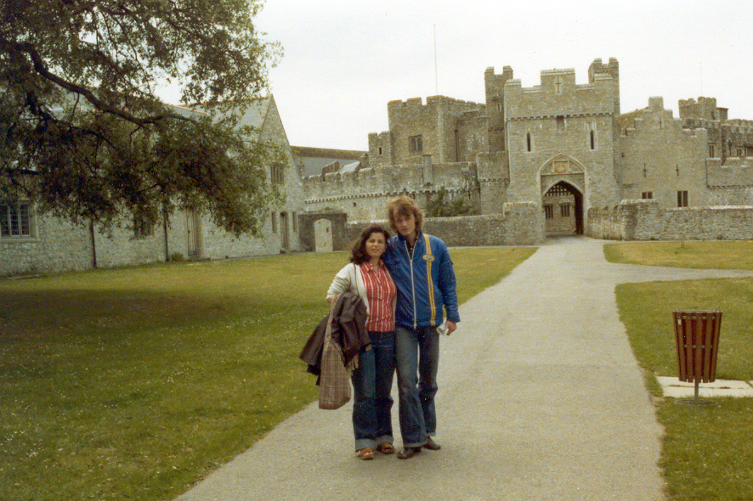
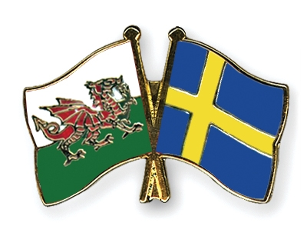

Slide 4
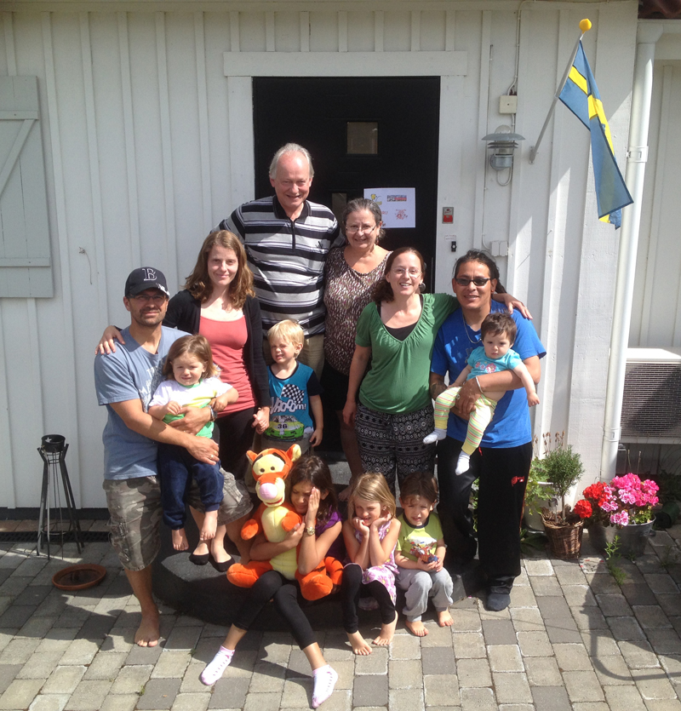

Slide 5

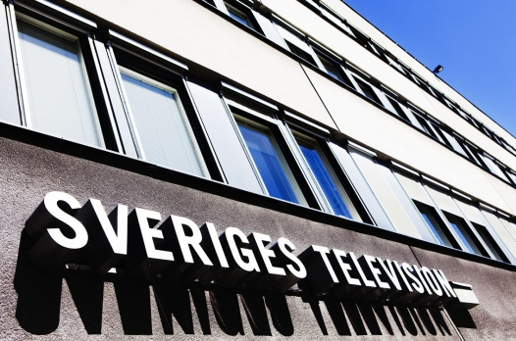






S. B. Jeffries Consultants

Slide 6
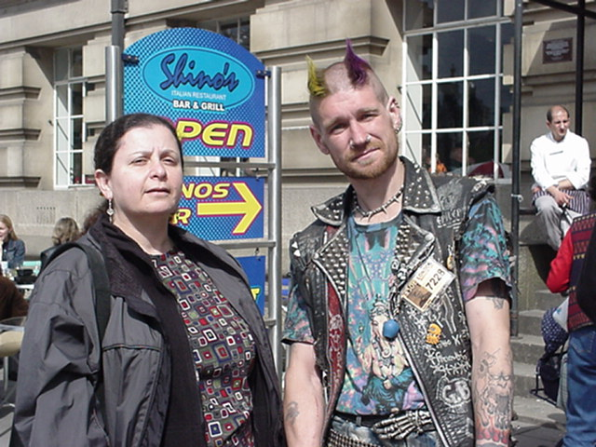
Notes:
2004: Över 1 miljon utrikes födda
Ca 300 tusen med utrikes födda föräldrar
Resor
Medielandskapet
Produkter

Slide 7
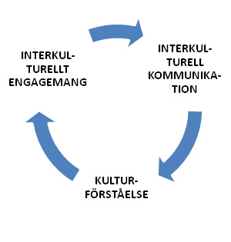
Cultural intelligence (CI)
The ability to make oneself understood and the ability to create a fruitful collaboration in situations where cultural differences play a role.
Motivation, courage, driving forces and stumbling blocks, subjective attitudes.
Intercultural engagement
Intercultural communication
what we actually do in the encounter.
Intercultural engagement
Cultural under-standing
Knowledge about culture (general) and about characteristics of various cultures (specific). Flexibility and ability to transfer experience from one encounter to another. Analyse what is going on.
(Ang & Van Dyne 2008; Livermore 2008; Plum 2008)

Slide 8
Components and dimensions of intercultural communication competences (ICC)
(Troncoso 2012)

Slide 9
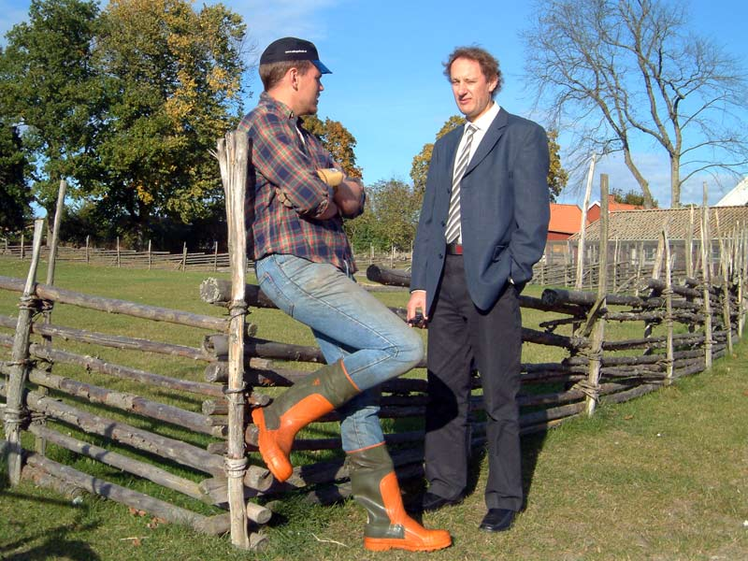
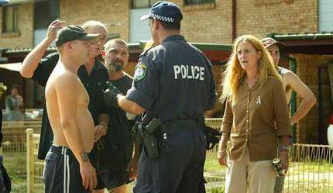
Intercultural communication is NOT ONLY about communication between people from different countries
Notes:
2004: Över 1 miljon utrikes födda
Ca 300 tusen med utrikes födda föräldrar
Resor
Medielandskapet
Produkter

Slide 10
Developing intercultural competence is essential for cross-cultural teaching initiatives and, in general, for navigating the continuum of globalization.
(Gopal 2011)

Slide 11
Effective global leaders are a vital asset for organizations today. In the current milieu of diversity, complexities, and international competition, having leaders who are capable of understanding, functioning, and managing in the global environment is a valuable, rare, and inimitable resource that can offer firms a competitive advantage.
(Ng, Van Dyne and Ang 2009)

Slide 12
Intercultural competence is especially important to educators, who must prepare all students for democratic life in a multicultural society. Teachers at all levels are experiencing an increase in the cultural and linguistic diversity of student populations. Consequently, they must rethink and possibly reform their educational practices to meet the needs of their diverse learners.
(Betse C. Esber, PhD, Pennsylvania State University)

Slide 13
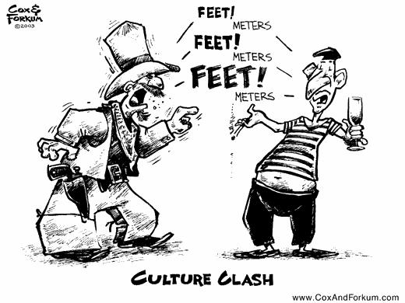

Slide 14
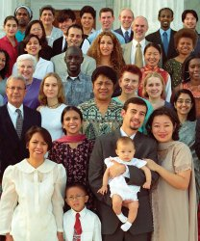
Today’s society – diverse by
definition and fragile in many ways
Globalisation
Migrations and mobility
Ongoing and arising conflicts
Challenges to humanity – need for sustainability

Slide 15
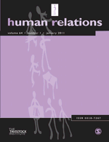

Surviving Post-merger ‘Culture Clash’: Can Cultural Leadership Lessen the Casualties?
Michelle C. Bligh
When Cultures Collide: The Anatomy of a Merger
Anthony F. Buono
  Bentley College
Culture Shock! How to Survive a Merger
By Liz Wolgemuth
Posted: March 31, 2008

Slide 16
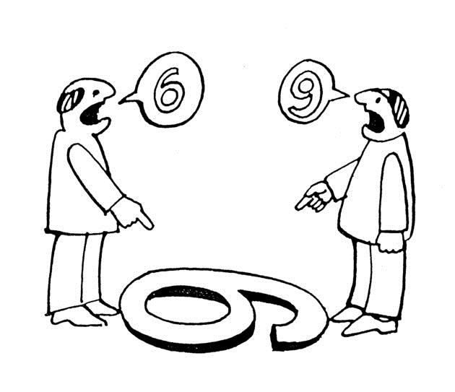

Slide 17
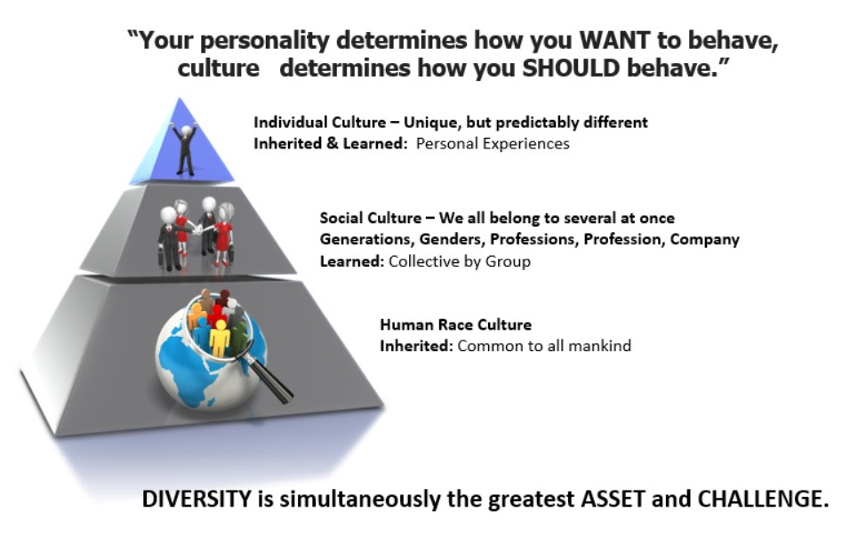

Slide 18
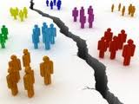
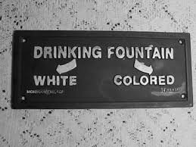
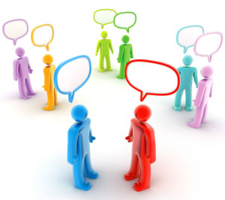
Multicultural
Intercultural
Notes:
Se till att er vistelse i utlandet inte begränsar sig till att vara i en multikulturell miljö (där kulturell mångfald kan förekomma utan kontakter mellan de olika grupperna) utan i en interkulturell miljö – som förutsätter interaktion.

Slide 19
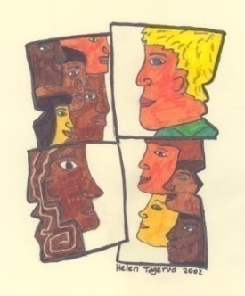
Intercultural communication is a process whereby people from different cultures integrate their resources, striving towards an optimal result that cannot be achieved by any culture individually (Klyukanov 2005)

Slide 20
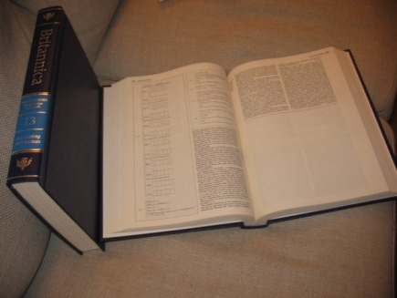
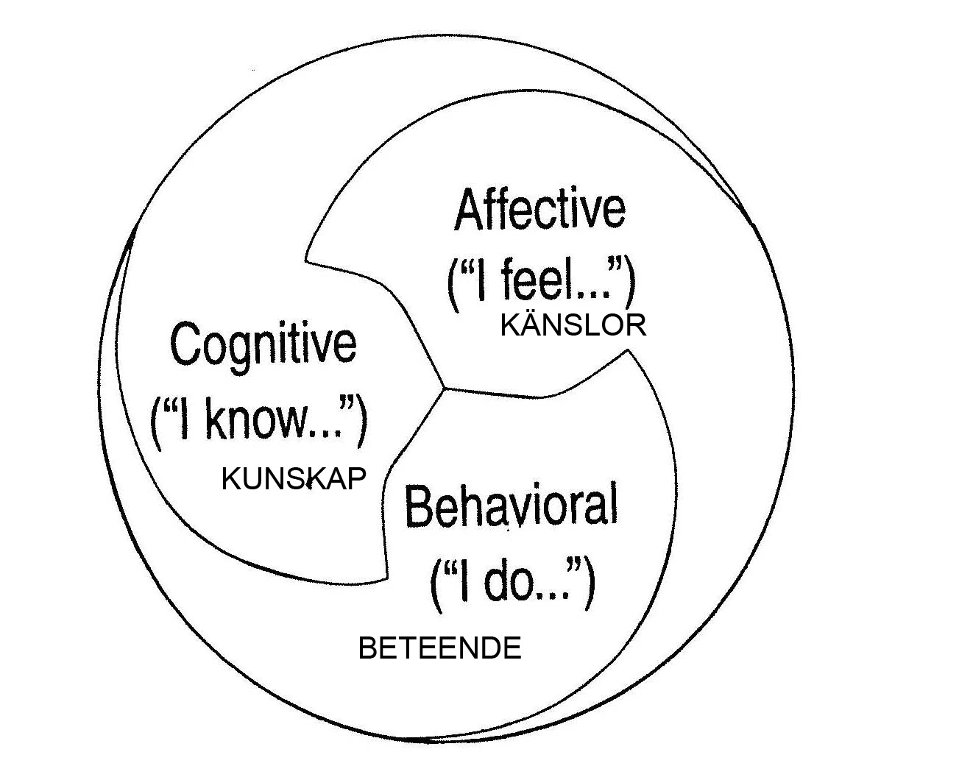
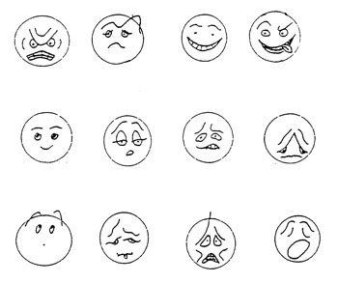
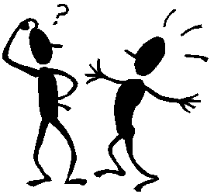
(based on Klyukanov 2005)
Notes:
Att förstå de olika delarna och reflektera över oss i själva och andra i förhållande till dessa aspekter kan hjälpa oss i praktiken i konkreta situationer
Kalmar FF – brasilianarna
Fanerdun/Kina satsningen i Kalmar
Lärare/studenter eller förhandlingssituationer inom affärsvärlden (samtalsmönster: att avbryta, att titta/stirra/undvika blick)

Slide 21
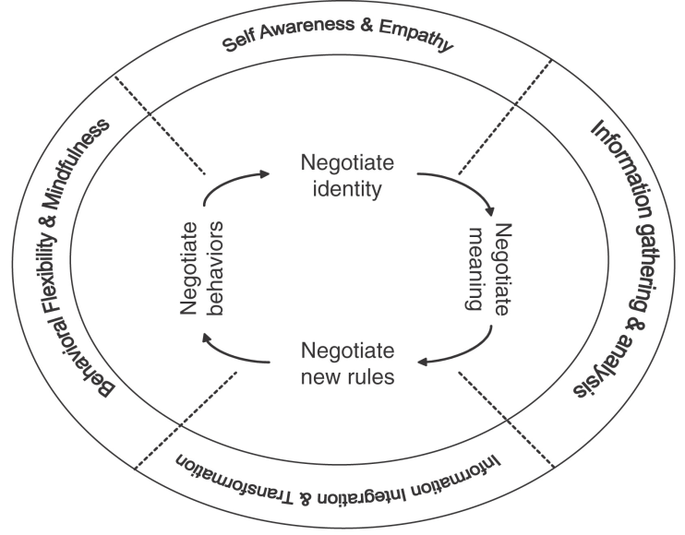
(TCMC Consulting)

Slide 22
Various approaches to ICC
Cultural general + cultural specific
Don’t take anything for granted
Distinguish between generalization and stereotyping
Reflect over your own stereotypes and ethnocentric approach
Remember to engage in metacommunication
Listen actively
Use feedback to assure hi-fi communication
Practice changing perspective and consider alternatives
Dare to move out of your comfort zone
Practice D-I-E (description-interpretation-evaluation)

Slide 23
Communication skills:
Verbal + non-verbal
Flexible behaviour patterns
Handling interactions
Social skills
Personal strength:
Self awareness
Self observation
Self disclosure
Social relaxation
Cultural insightfullness:
Realizing the complexity of cultures
Understanding and integrating diversified cultural systems
Psychological adjustment:
Acclimatization to different environments
Handle cultural shock

Slide 24
Attention (mindfulness)
  Create new categories
  Openness to new information
  Cultural relativism – multiperspective
Allow ambiguity
  Cope with lack of information
  Cope with information that does not make sense initially

Slide 25
Four central cultural competence skills:
Cultural due diligence – assess & prepare
Style switching – broad & flexible behavioural repertoir
Cultural dialogue – negotiate new standards
Cultural mentoring – facilitate adaptation and learning
Notes:
Cultural due diligence – the ability to assess and prepare for the possible impact of cultural differences and similarities
Style switching – the ability to use a broad and flexible behavioral repertoire to accomplish one’s goals
Cultural dialogue – the ability to negotiate new and common cultural standards
Cultural mentoring – the ability to facilitate the cultural adaptation and learning of individuals and groups

Slide 26
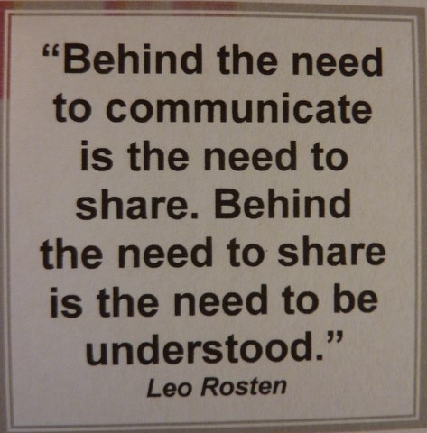
Metacommunication
Communication about communication

Slide 27
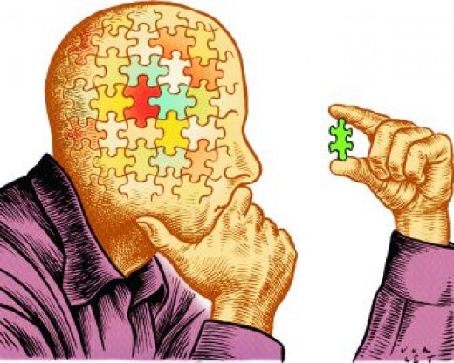

Slide 28
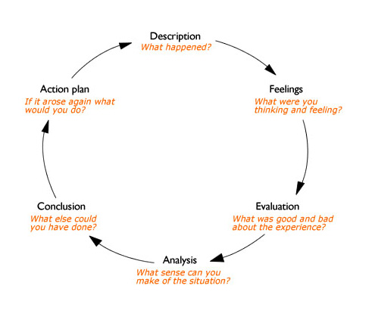


Slide 29


Slide 30
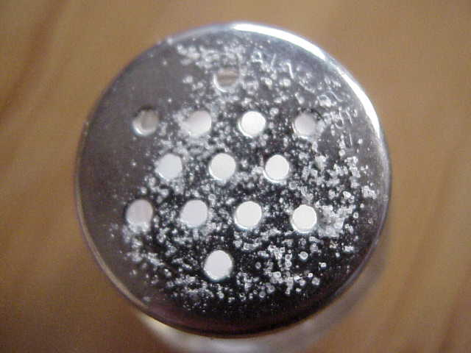

Slide 31
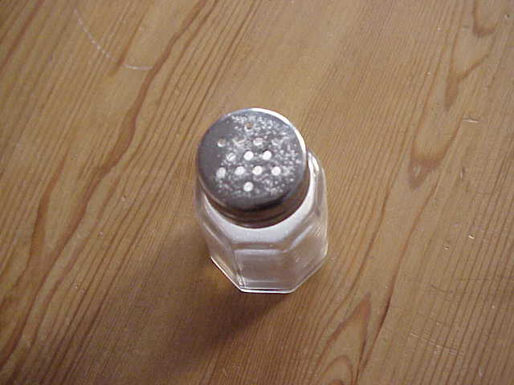
Notes:
Så betraktar vi vår omgivning – vår utgångspunkt när vi jämför kulturer och ledarskapsstilar.

Slide 32
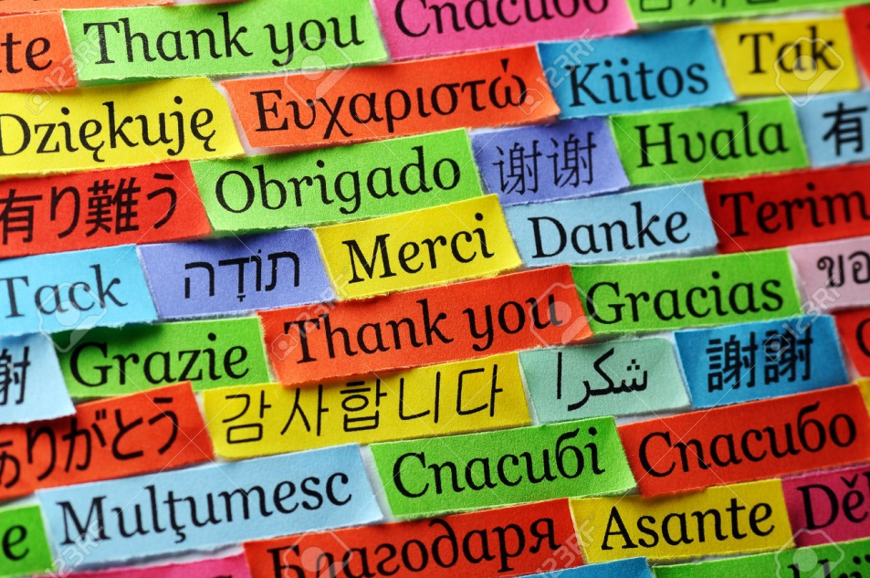
Yael.tagerud@lnu.se

